Slide 1

Positioning

Slide 2
Positioning Elements with CSS
With the exception of floating elements right or left, we have thus far allowed our page elements to appear one after another down the screen. Using CSS, we can depart from this normal flow in order to:
force an element to stay fixed in the same place in the browser window, even while the user continues to scroll further down the page.
move elements up, down, right, or left relative to their normal position on the page.
remove elements from their normal position and place them in a precise location within the page content.
allow elements to overlap and to specify which appears in front and which appears in back.

Slide 3
Positioning Properties and Values
The CSS position property has four different values we will use:
static - places the element in its usual location in the normal document flow. This is the default value.
fixed - removes the element from the normal document flow and fixes it to a specific location in the browser window. Even when the page is scrolled, its location will remain the same.
relative - keeps the element in the normal document flow but allows us to move it around relative to its normal location.
absolute - removes the element from the normal document flow and allows us to place it in a specific location. It will scroll along with the surrounding page content.
The position property is used in conjunction with the top, bottom, right, and left CSS properties. Let's see some examples how these work together.

Slide 4
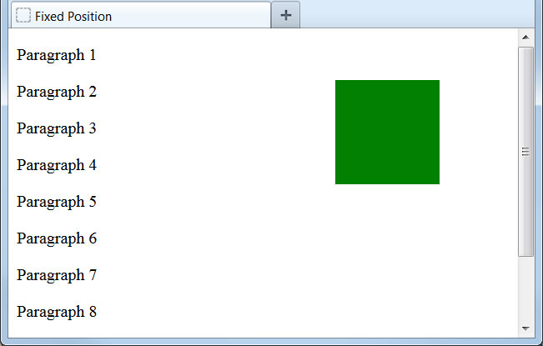
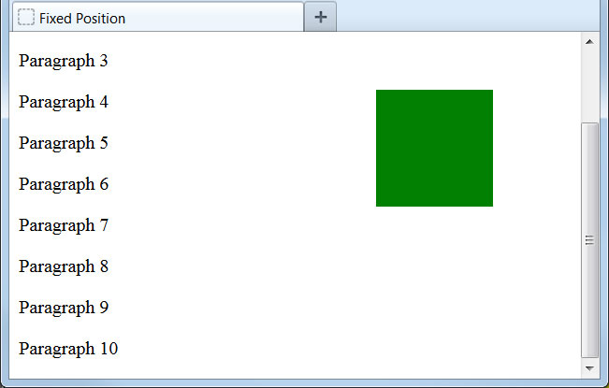
Fixed Position
Let's use the position property to fix an element to a specific location in the browser window:
.box1 {
height: 100px;
width: 100px;
background-color: green;
position: fixed;
top: 50px;
right: 75px;
}
...
<div class="box1"></div>
<p>Paragraph 1</p>
<p>Paragraph 2</p>
...
We have pinned this element to a fixed location, 50px from the top edge and 75px from the right edge of the browser window. Even as we scroll the page content, the element remains in the same place.

Slide 5
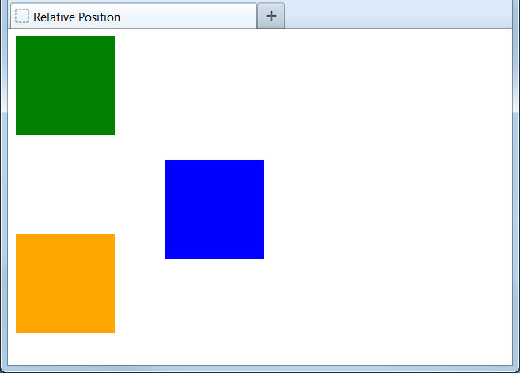
Relative Position
Now let's move an element relative to its normal position:
.box1 {
height: 100px;
width: 100px;
background-color: green;
}
.box2 {
height: 100px;
width: 100px;
background-color: blue;
position: relative;
top: 25px;
left: 150px;
}
.box3 {
height: 100px;
width: 100px;
background-color: orange;
}
...
<div class="box1"></div>
<div class="box2"></div>
<div class="box3"></div>
Using relative position, we can nudge elements or even move them to the other side of the page.
Remember that relative positioning keeps the element in the normal document flow. No matter where we move the element, its original location will be reserved on the screen.

Slide 6
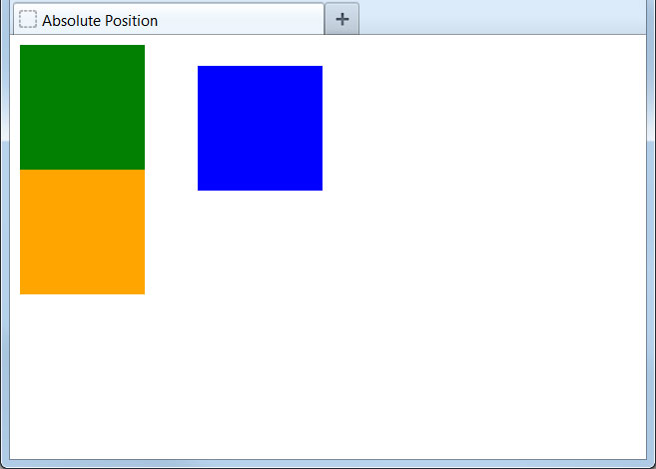
Absolute Position
Here we will change the element to have an absolute position:
.box1 {
height: 100px;
width: 100px;
background-color: green;
}
.box2 {
height: 100px;
width: 100px;
background-color: blue;
position: absolute;
top: 25px;
left: 150px;
}
.box3 {
height: 100px;
width: 100px;
background-color: orange;
}
...
<div class="box1"></div>
<div class="box2"></div>
<div class="box3"></div>
Absolute positioning places the element not relative to its normal position but from the top left corner of the page.
Like fixed positioning, absolute positioning removes the element from the normal document flow. Other elements will appear on the page the same as if this element did not exist.

Slide 7
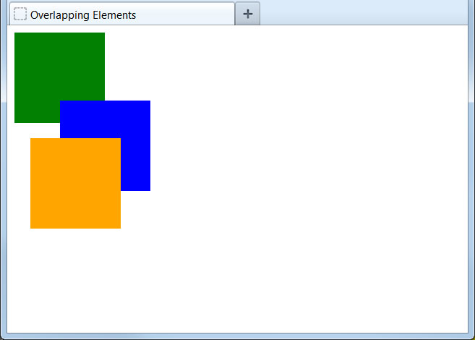
Overlapping Elements
Positioning elements can cause them to overlap on the page:
.box1 {
height: 100px;
width: 100px;
background-color: green;
}
.box2 {
height: 100px;
width: 100px;
background-color: blue;
position: relative;
top: -25px;
left: 50px;
}
.box3 {
height: 100px;
width: 100px;
background-color: orange;
position: absolute;
top: 125px;
left: 25px;
}
...
By default, the element last added to the page will appear on top of all others and the first element will appear below all others.
Note that we can set position values to be negative numbers. This can even be used to pull elements partially off the visible page.

Slide 8
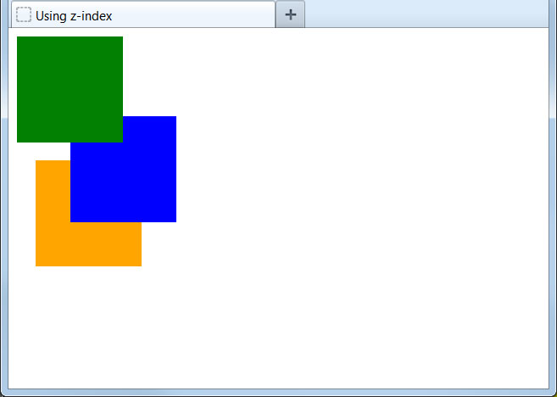
Controlling the Overlap
We can override the default precedence by setting the z-index property:
.box1 {
height: 100px;
width: 100px;
background-color: green;
position: relative;
z-index: 3;
}
.box2 {
...
position: relative;
top: -25px;
left: 50px;
z-index: 2;
}
.box3 {
...
position: absolute;
top: 125px;
left: 25px;
z-index: 1;
}
...
Higher z-index values will always appear on top of lower ones, so we can precisely control how elements stack on the page.
For the z-index to work, an element must be positioned as relative, absolute, or static.

Slide 9
Display: float
Floating Elements

Slide 10

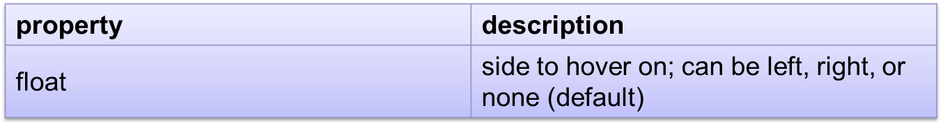
The CSS float property (reference)
img.headericon {
float: right;
width: 130px;
} CSS
Ghostbusters is a 1984 American science fiction comedy
film written by co-stars Dan Aykroyd and Harold Ramis
about three eccentric New York City
parapsychologists-turned-ghost capturers.
output
removed from normal document flow; underlying text wraps around as necessary

Slide 11
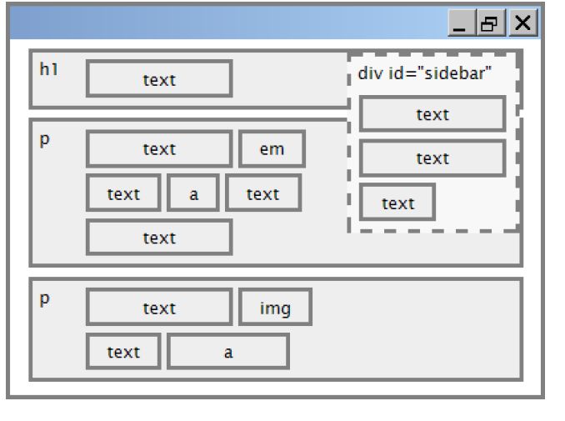
Floating elements diagram
CS380

Slide 12
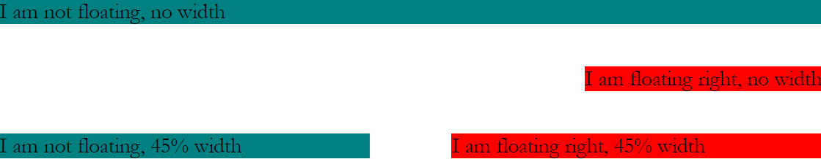
Common float bug: missing width
often floating block elements must have a width property value
Let’s try “floating”
CS380
Notes:
if no width is specified, the floating element may occupy 100% of the page width, so no content can wrap around it

Slide 13
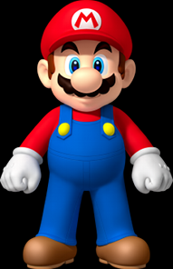
The clear property
p { background-color: fuchsia; }
h2 { clear: right;
background-color: yellow;
} CSS
Mario is a fictional character in his video game series.
Serving as Nintendo's mascot and the main protagonist
of the series, Mario has appeared in over 200 video
games since his creation.
output
Mario is a fictional character in his video game series. Serving as Nintendo's mascot and the main protagonist of the series, Mario has appeared in over 200 video games since his creation
Super Mario Fan Site!
CS380

Slide 14
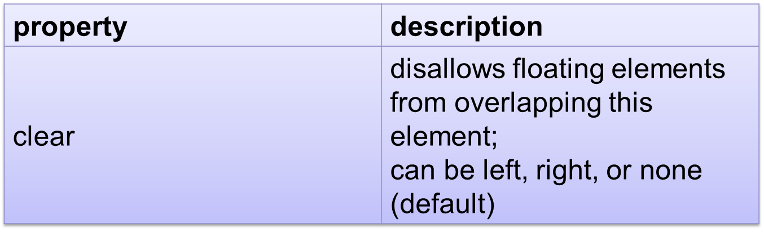
The clear property (cont.)
CS380

Slide 15
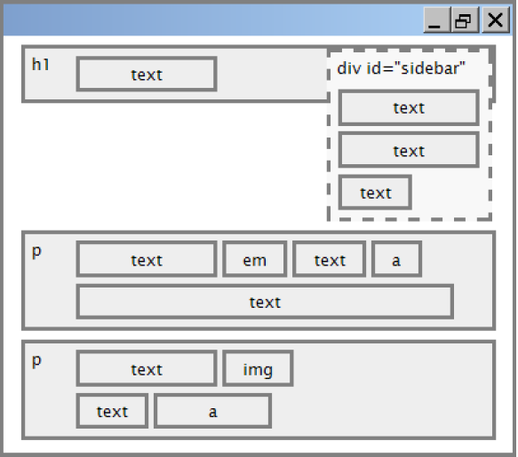
Clear diagram
div#sidebar { float: right; }
p { clear: right; } CSS
CS380

Slide 16
Common error: container too short
<p><img src="images/mario.png" alt=“super mario" />
Mario is a fictional character in his video game series.....</p> HTML
p { border: 2px dashed blue; }
img { float: right; } CSS
Mario is a fictional character in his video game series.
Serving as Nintendo's mascot and the main protagonist
of the series, Mario has appeared in over 200 video
games since his creation.
output
Notes:
We want the p containing the image to extend downward so that its border encloses the entire image

Slide 17
The overflow property
p { border: 2px dashed black;
overflow: hidden; } CSS
Mario is a fictional character in his video game series.
Serving as Nintendo's mascot and the main protagonist
of the series, Mario has appeared in over 200 video
games since his creation.
output
CS380
Notes:
We want the p containing the image to extend downward so that its border encloses the entire image

Slide 18
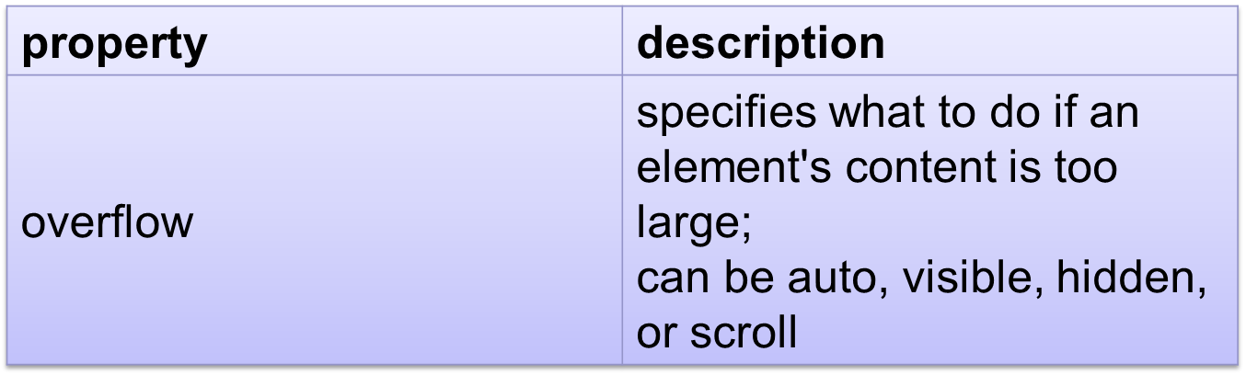
The overflow property (cont.)
CS380
Notes:
We want the p containing the image to extend downward so that its border encloses the entire image

Slide 19
Multi-column layouts
<div>
<p>first paragraph</p>
<p>second paragraph</p>
<p>third paragraph</p>
Some other text that is important
</div> HTML
p { float: right; width: 25%; margin: 0.5em;
border: 2px solid black; }
div { border: 3px dotted green; overflow: hidden; } CSS
Some other text that is important
output
third paragraph
second paragraph
first paragraph
Notes:
We want the p containing the image to extend downward so that its border encloses the entire image

Slide 20
Flex Box

Slide 21
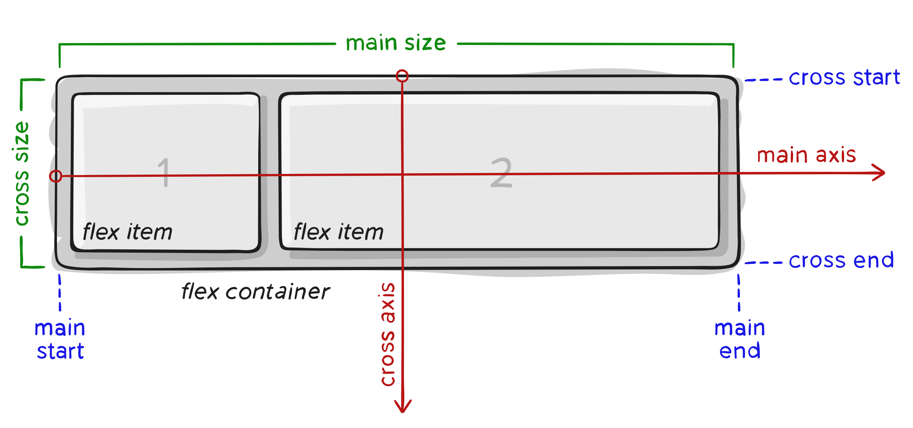
Terminology
Since flexbox is a whole module and not a single property, it involves a lot of things including its whole set of properties. Some of them are meant to be set on the
container (parent element, known as “flex container”)
children (said “flex items”).

Slide 22
Terminology
main axis – The main axis of a flex container is the primary axis along which flex items are laid out. Beware, it is not necessarily horizontal; it depends on the flex-direction property (see below).
main-start | main-end – The flex items are placed within the container starting from main-start and going to main-end.
main size – A flex item’s width or height, whichever is in the main dimension, is the item’s main size. The flex item’s main size property is either the ‘width’ or ‘height’ property, whichever is in the main dimension.

Slide 23
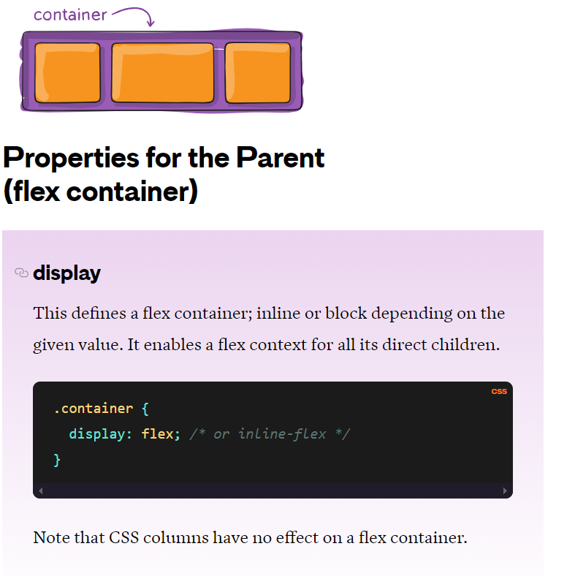

Slide 24
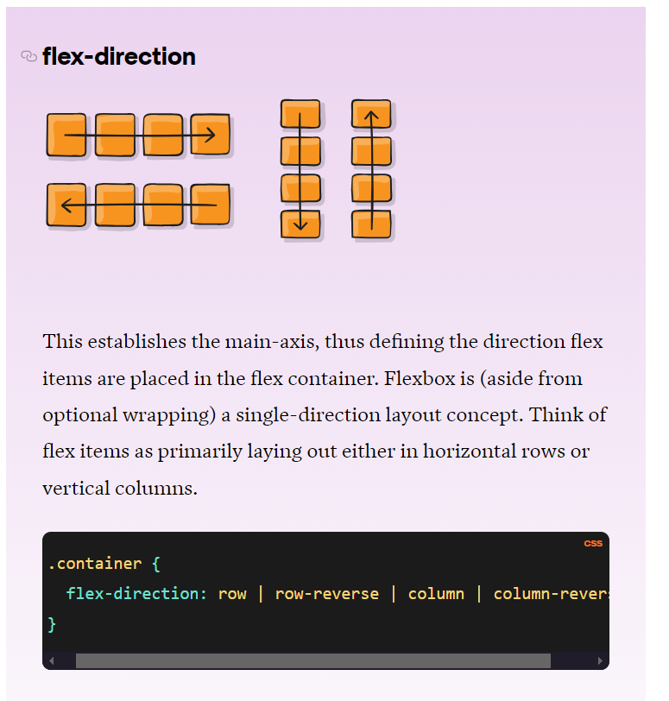

Slide 25
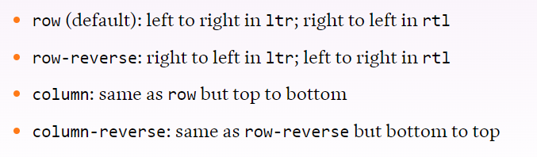
Flex direction

Slide 26
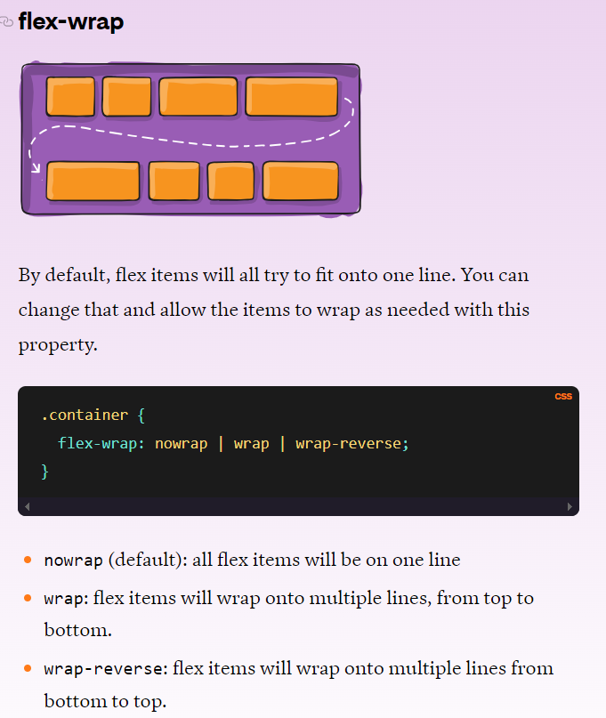

Slide 27
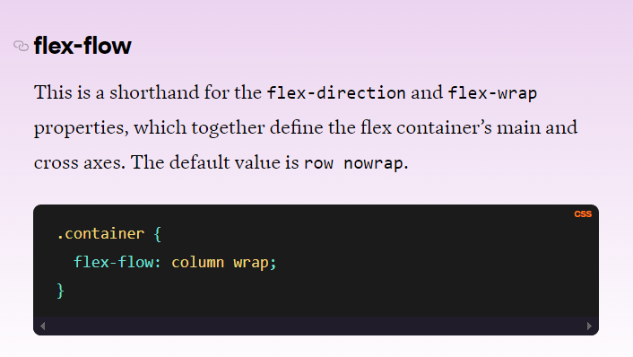

Slide 28
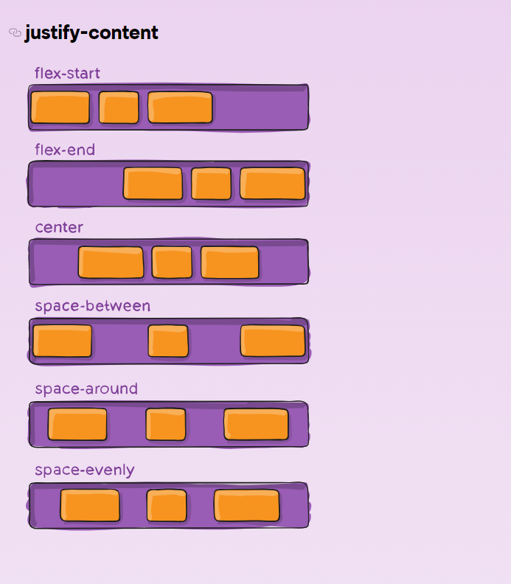

Slide 29
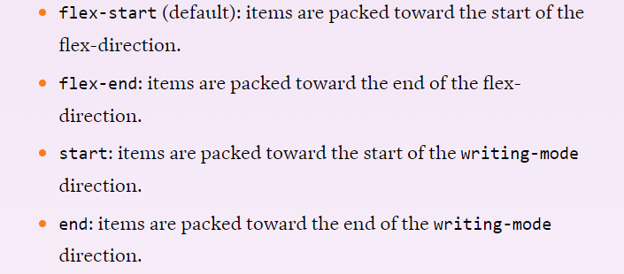
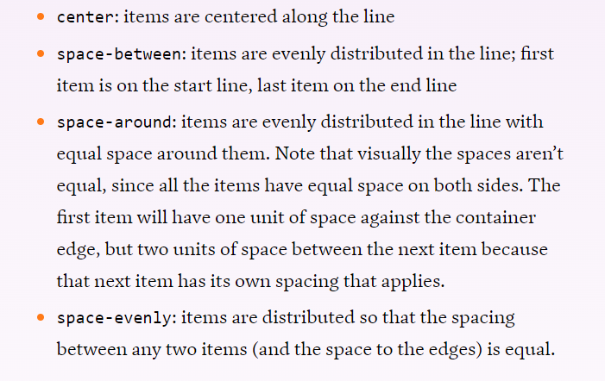

Slide 30
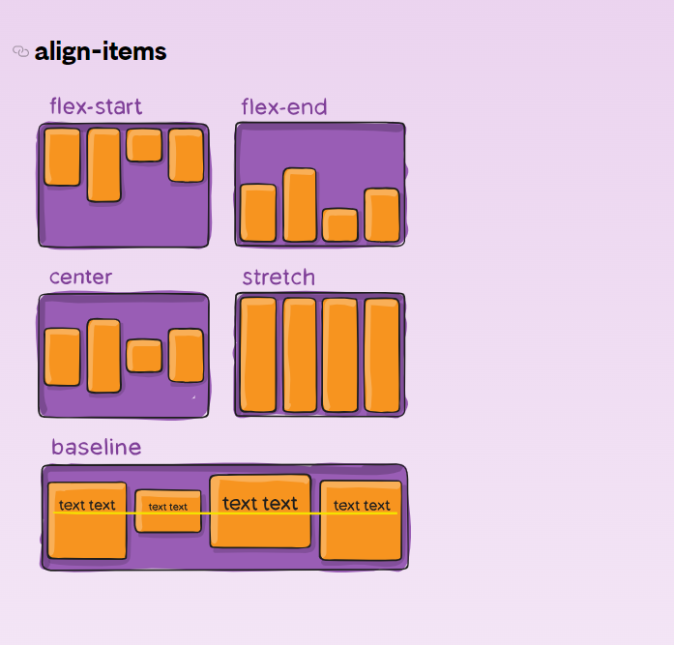

Slide 31
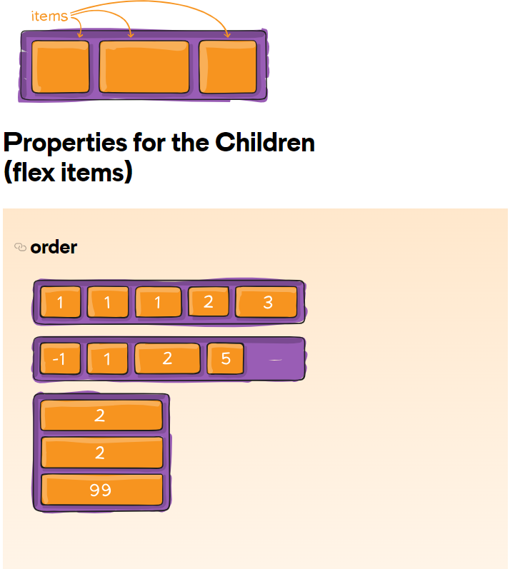

Slide 32
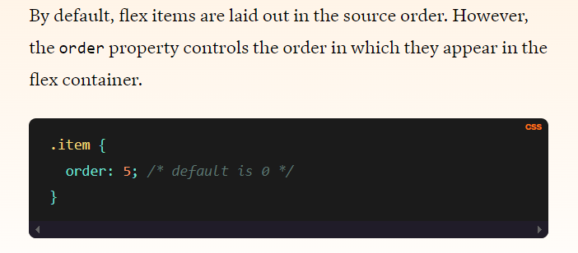

Slide 33
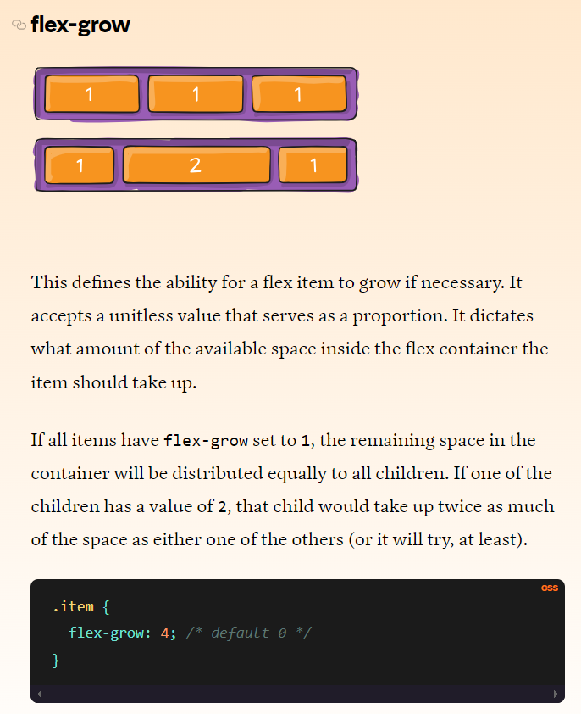

Slide 34
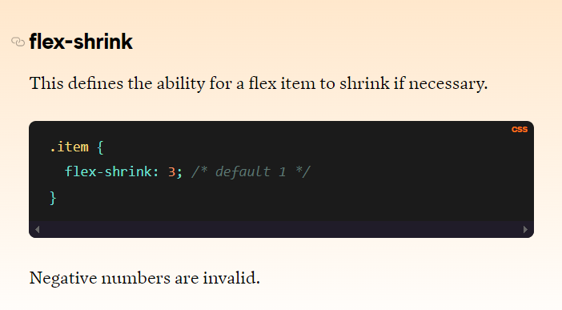

Slide 35
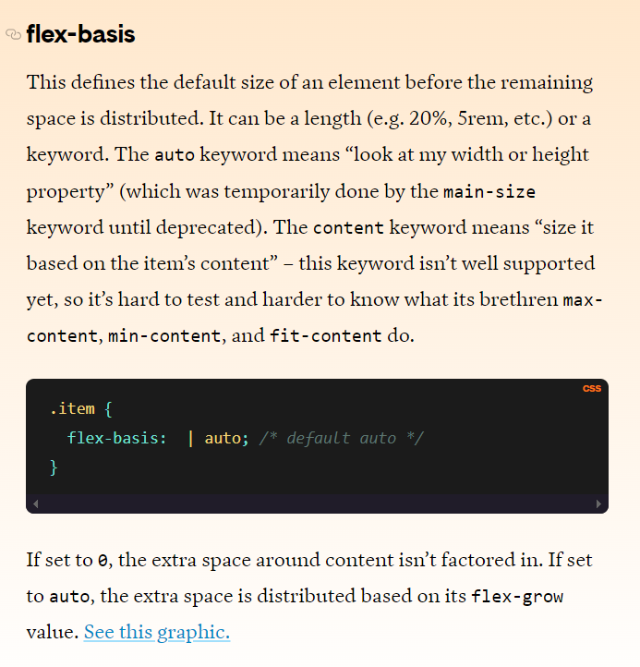

Slide 36
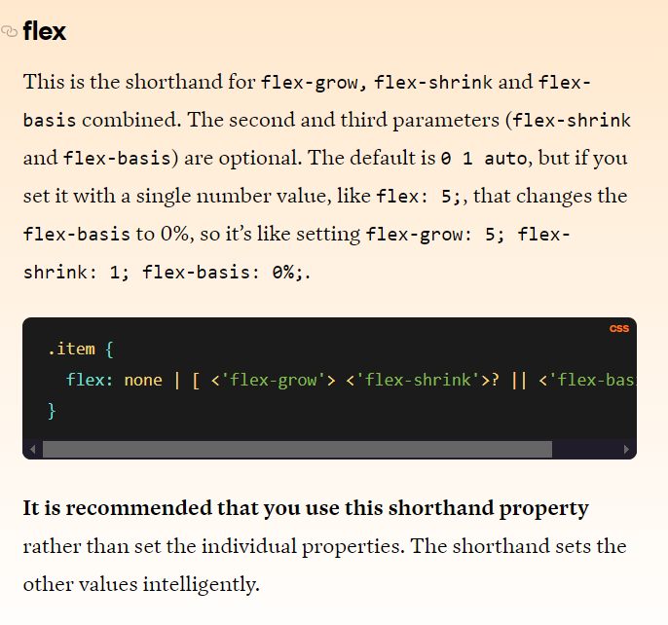

Slide 37
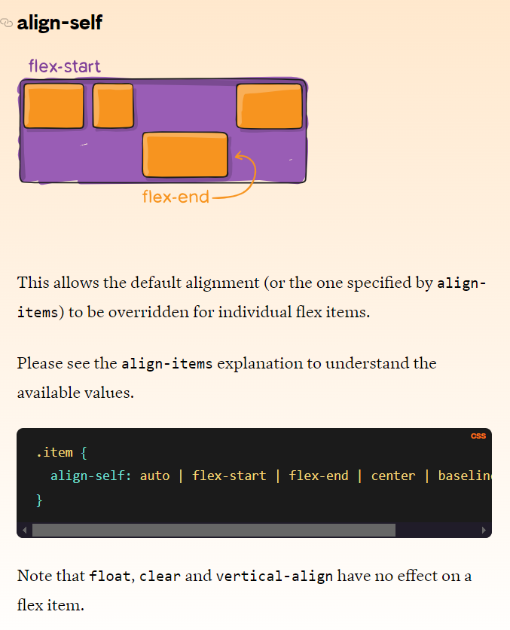

Slide 38
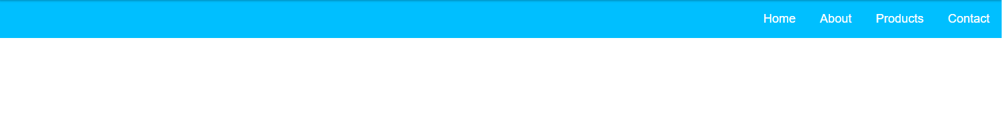
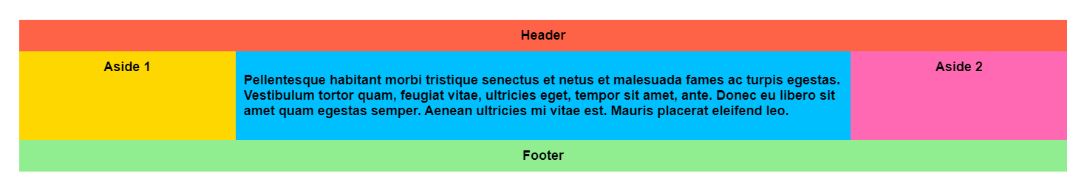
Examples
1
2

